Slide 1
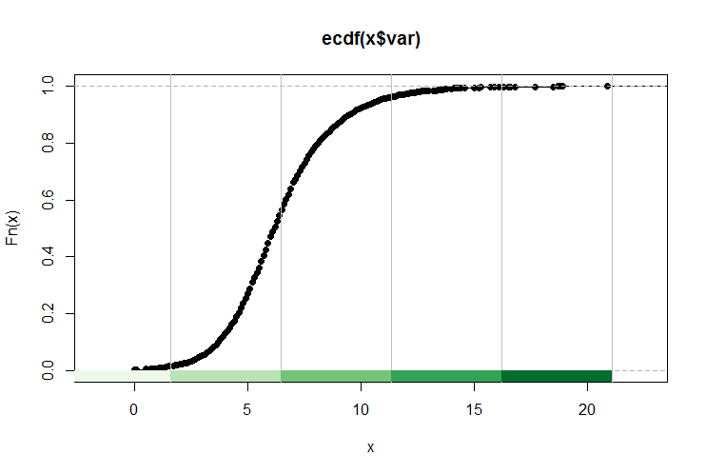
Week 10:Normality testing; Chi-square; Non-parametric tests
Geog4300: Harper
October 23, 2025

Slide 2
Today’s plan
Testing for normality
If data is not normally distributed –Wilcoxon test
If the two variables being tested are categorical rather than continuous – Chi-squared test
Introduce Lab 4

Slide 3
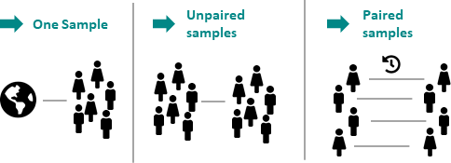
Continuous
σ known and n > 30
Continuous
σ unknown or n < 30
Use Z-test and Z statistic. Standard error = SE = σ/sqrt(n)
Use t-test and t statistic. Standard error = SE = s/sqrt(n-1)
Notes:
Reminder: One sample: We use a t-test, unless the actual standard deviation is known and n>30, then we use the z score. The difference in practice is very small.

Slide 4
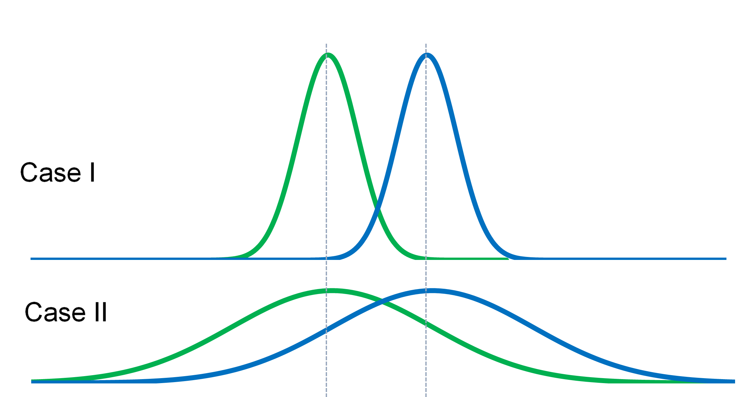
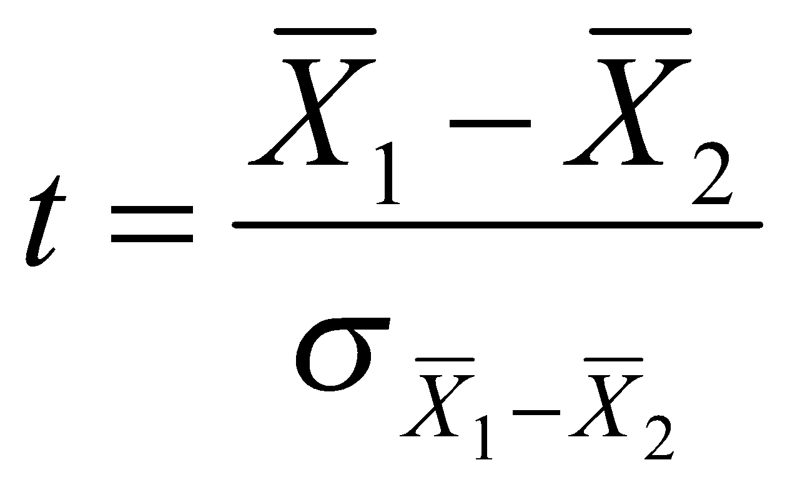
Two sample t-tests
Instead of comparing one sample against a predetermined mean, identifying difference between two samples
Notes:
Alternative hypothesis is usually what you’re trying to prove.

Slide 5
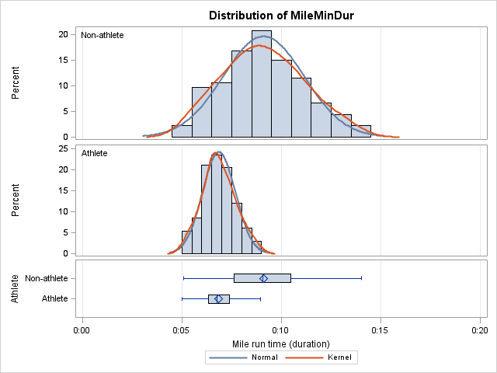
Two sample t-tests
Key question #1: Is the variance in both samples even or uneven?
Notes:
Alternative hypothesis is usually what you’re trying to prove.

Slide 6
Key question #1: Is the variance in both samples even or uneven?
Look at the 2019 census data and compute the standard deviation for two categories of racial classification. How do those compare?
Variance = Standard deviation^2
Notes:
Alternative hypothesis is usually what you’re trying to prove.

Slide 7
Two sample t-tests
Key question #2: Are the samples independent or paired?
Notes:
Alternative hypothesis is usually what you’re trying to prove.

Slide 8
Are the samples independent or paired?
On a sheet of paper, write down two research questions for your area of interest. One should use two independent samples and one should use a paired sample.
Notes:
Alternative hypothesis is usually what you’re trying to prove.

Slide 9
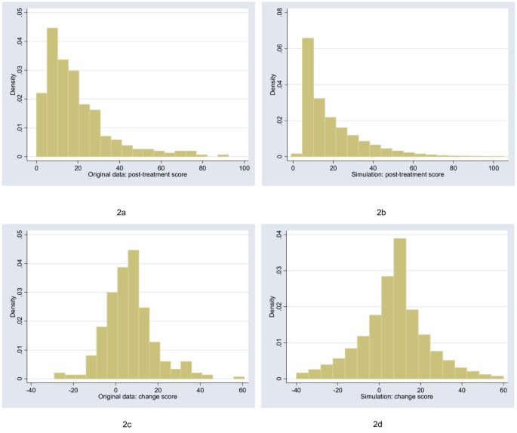
Two sample t-tests
Number of named Atlantic tropical storms, years
Key question #3: Are the samples parametric (normal) or non-parametric?
El Nino | La Nina
0 (1.5) | 4 (12)
5 (15) | 4 (12)
1 (3.5) | 12 (21)
3 (9) | 2 (6.5)
4 (12) | 17 (22)
1 (3.5) | 7 (18)
2 (6.5) | 6 (16.5)
2 (6.5) | 10 (20)
0 (1.5) | 4 (12)
2 (6.5) | 8 (19)
4 (12) | 6 (16.5)
W₁ = 77.5 W₂ = 175.5
Notes:
Alternative hypothesis is usually what you’re trying to prove.

Slide 10
Two sample t-tests
Key question #1: Is the variance in both samples even or uneven?
Key question #2: Are the samples independent or paired?
Key question #3: Are the samples parametric (normal) or non-parametric?
How do we test for normality?

Slide 11
What if your samples aren’t normal?
Number of named Atlantic tropical storms, years
Random sample of hurricanes in El Nino and La Nina years—11 each
You need a non-parametric test with data that’s not normal.
El Nino | La Nina
0 | 4
5 | 4
1 | 12
3 | 2
4 | 17
1 | 7
2 | 6
2 | 10
0 | 4
2 | 8
4 | 6

Slide 12
Wilcoxon Rank Sum test
Number of named Atlantic tropical storms, years
Question: Is the number of Atlantic storms significantly different in El Nino years compared to La Nina years?
El Nino | La Nina
0 | 4
5 | 4
1 | 12
3 | 2
4 | 17
1 | 7
2 | 6
2 | 10
0 | 4
2 | 8
4 | 6
See lecture video for the details of what’s going on ‘under the hood’

Slide 13
Two sample t-tests
Number of named Atlantic tropical storms, years
Key question #3: Are the samples parametric (normal) or non-parametric?
El Nino | La Nina
0 (1.5) | 4 (12)
5 (15) | 4 (12)
1 (3.5) | 12 (21)
3 (9) | 2 (6.5)
4 (12) | 17 (22)
1 (3.5) | 7 (18)
2 (6.5) | 6 (16.5)
2 (6.5) | 10 (20)
0 (1.5) | 4 (12)
2 (6.5) | 8 (19)
4 (12) | 6 (16.5)
W₁ = 77.5 W₂ = 175.5
Notes:
Alternative hypothesis is usually what you’re trying to prove.

